Slide 1

Intermediate thesis presentation
Analysing Sectoral Unemployment Dynamics in the United States Using Autoregressive Models for Matrix-Valued Time Series
Igor Vasilev · UM SBE · May 6, 2026

Slide 2
Research question
We want to understand unemployment dynamics across economic sectors and states. To achieve this, we use the Matrix Autoregressive model (MAR) - a parsimonious extension of VAR designed for matrix-valued time series.

Slide 3
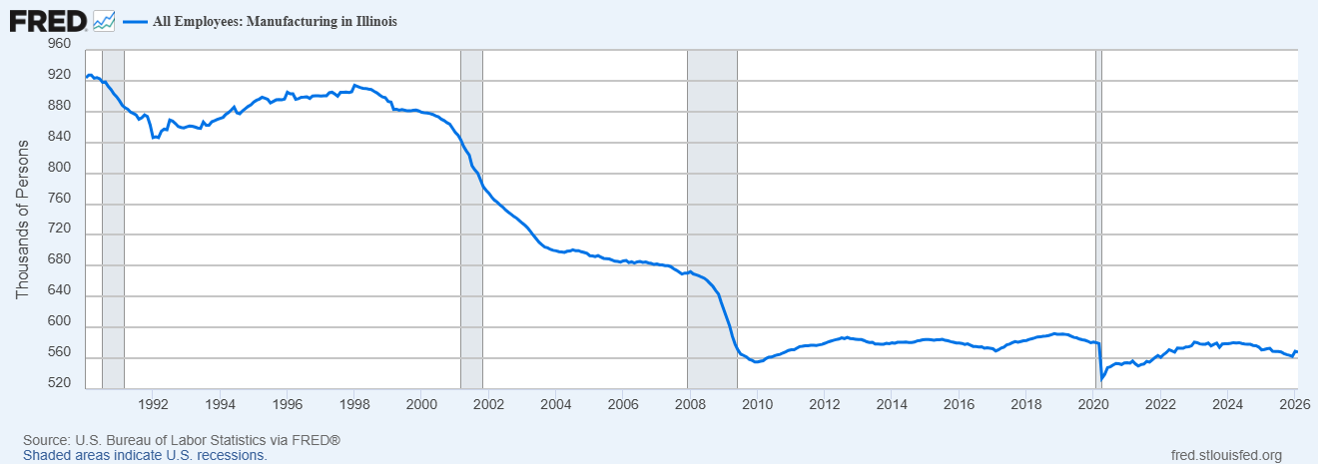
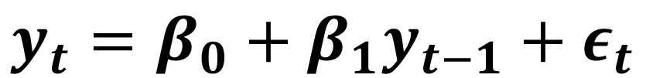
First case
$$y_{t}=β_{0}+β_{1}y_{t−1}+ε_{t}$$
1 State 1 Sector (Manufacturing in Illinois)
All Employees: Manufacturing in Illinois

Slide 4
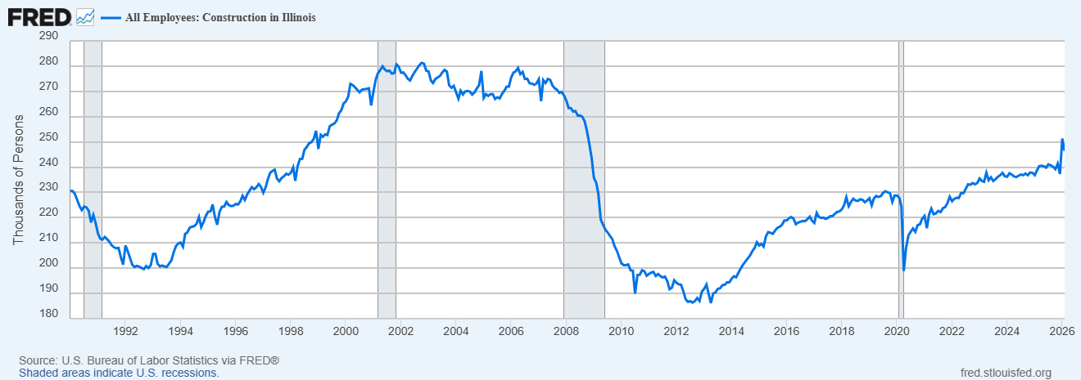
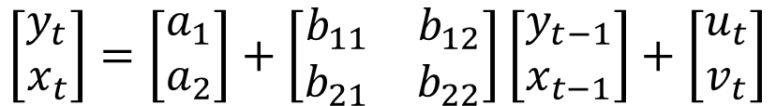


Second case
1 State 2 Sectors (Manufacturing and Construction in Illinois)
Vector Auto-Regression (VAR) Model - Bivariate VAR(1) — Vector and Matrix Form
Example Bivariate VAR(1) model - (yₜ, xₜ) and one lag:
$$y_{t}=a_{1}+b_{11}y_{t−1}+b_{12}x_{t−1}+u_{t}$$
All Employees: Manufacturing in Illinois
$$x_{t}=a_{2}+b_{21}y_{t−1}+b_{22}x_{t−1}+v_{t}$$
Matrix Representation
$$\left[\begin{matrix}y_{t} \\ x_{t}\end{matrix}\right]=\left[\begin{matrix}a_{1} \\ a_{2}\end{matrix}\right]+\left[\begin{matrix}b_{11} & b_{12} \\ b_{21} & b_{22}\end{matrix}\right]\left[\begin{matrix}y_{t−1} \\ x_{t−1}\end{matrix}\right]+\left[\begin{matrix}u_{t} \\ v_{t}\end{matrix}\right]$$
All Employees: Construction in Illinois

Slide 5
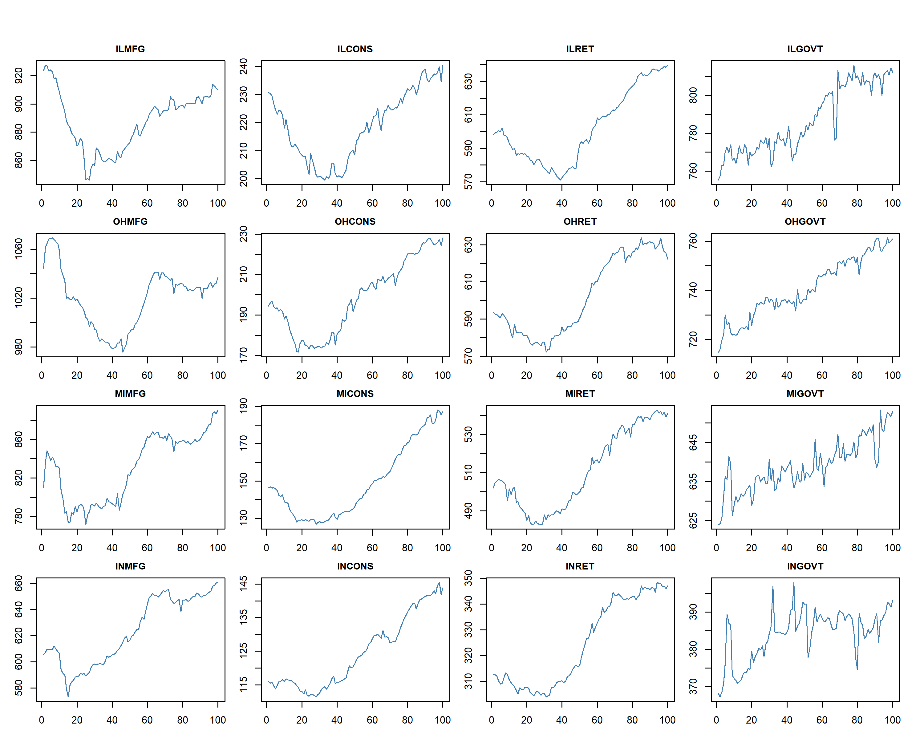
Third case
4 Sectors: - Manufacturing - Construction - Retail Trade - Government
4 States: - Illinois - Ohio - Michigan - Indiana
Time dimension
Together, sectors × states × time form a 3-dimensional tensor

Slide 6
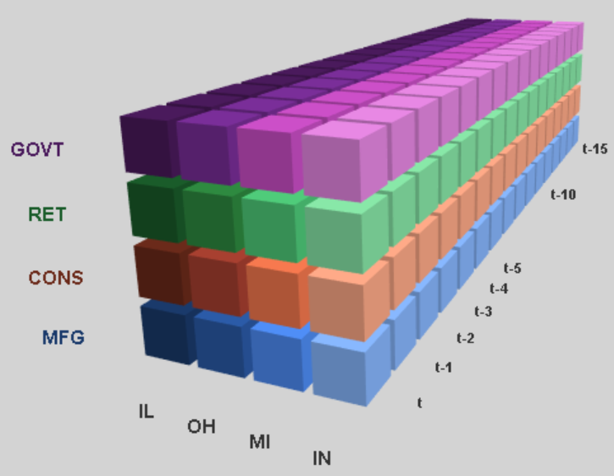
Tensor Format Data
Colors represent different sectors: - Purple GOVT – Government - Green RET – Retail Trade - Orange CONS – Construction - Blue MFG – Manufacturing
Gradient represents different states: - IL – Illinois - OH – Ohio - MI – Michigan - IN – Indiana

Slide 7
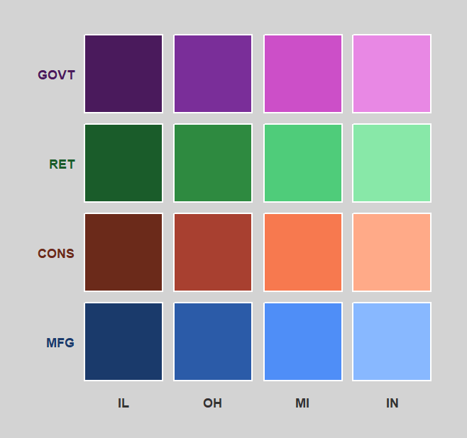
What do we want?
Time t
Time t-1
We want to estimate how the employment matrix at time t-1 linearly predicts the matrix at time t, capturing both cross-state and cross-sector dynamics simultaneously.

Slide 8

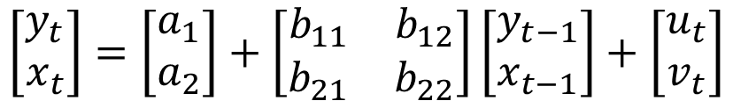

Vector Auto Regression (VAR)
Example Bivariate VAR(1) model - (yₜ, xₜ) and one lag:
$$y_{t}=a_{1}+b_{11}y_{t−1}+b_{12}x_{t−1}+u_{t}$$
$$x_{t}=a_{2}+b_{21}y_{t−1}+b_{22}x_{t−1}+v_{t}$$
Matrix Representation
$$\left[\begin{matrix}y_{t} \\ x_{t}\end{matrix}\right]=\left[\begin{matrix}a_{1} \\ a_{2}\end{matrix}\right]+\left[\begin{matrix}b_{11} & b_{12} \\ b_{21} & b_{22}\end{matrix}\right]\left[\begin{matrix}y_{t−1} \\ x_{t−1}\end{matrix}\right]+\left[\begin{matrix}u_{t} \\ v_{t}\end{matrix}\right]$$

Slide 9
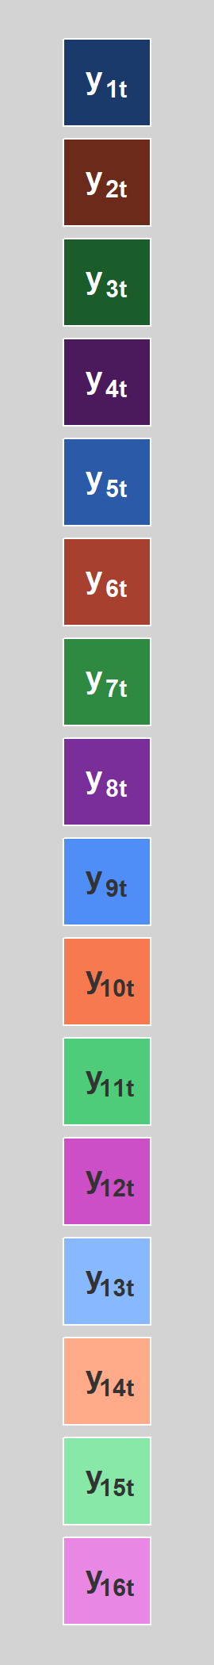
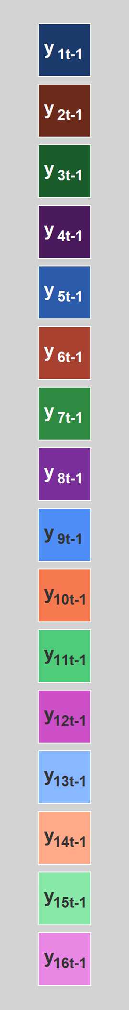

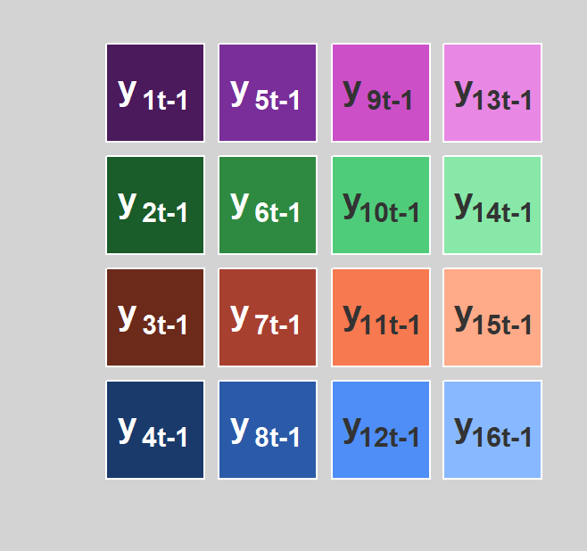
Stacking
Time t
Time t-1
Instead of sector/state labels, assign numeric indices to each cell.
Stack all columns on top of each other to obtain a 16-dimensional vector. This is the standard VAR representation.

Slide 10
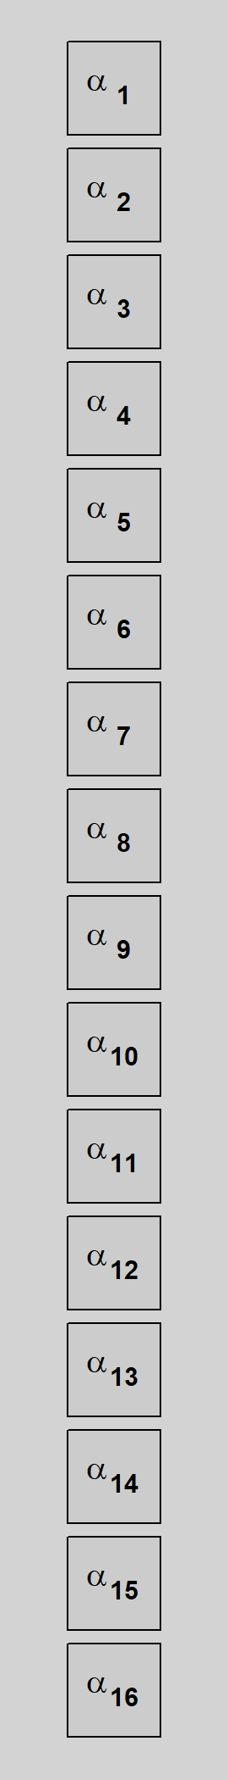
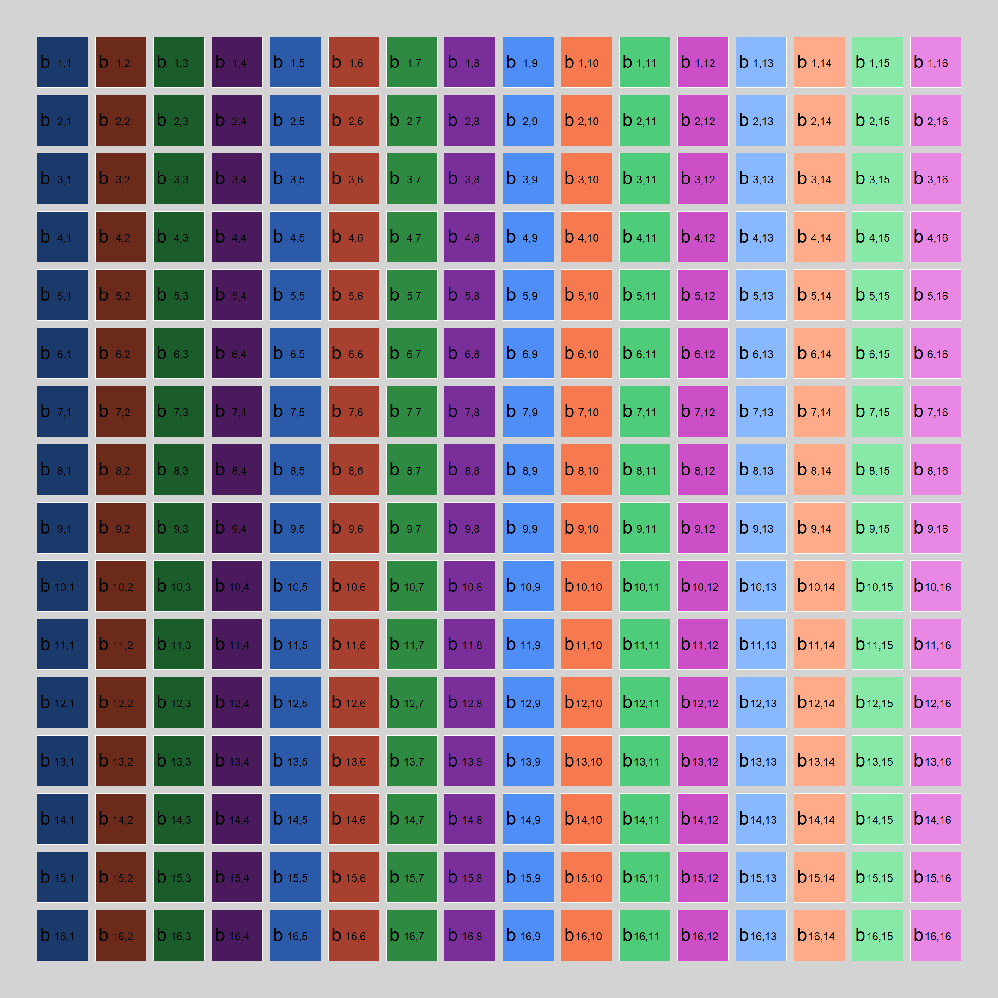
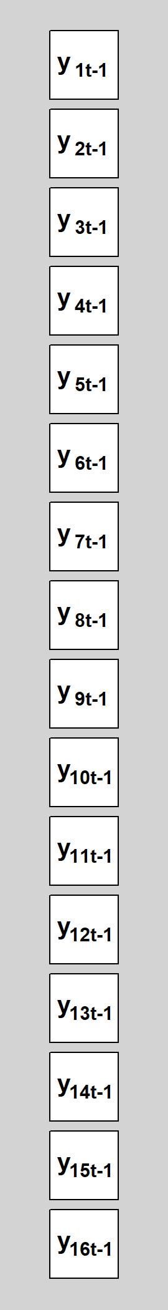
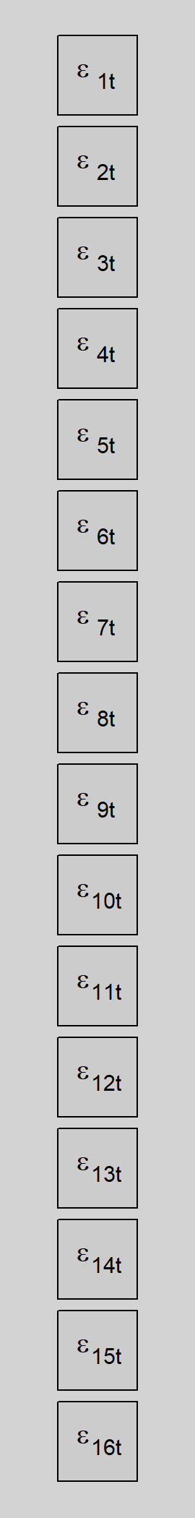
Problem?
The coefficient matrix B contains 256 parameters (16 × 16)
Our goal is to understand dynamics - not to identify every pairwise state-sector relationship
This is the parsimony problem: too many parameters relative to the signal we seek
Solution: impose structure by decomposing B into two smaller matrices A (4 × 4) and B (4 × 4), reducing parameters to 32
=
+
x
+
$$\left[\begin{matrix}y_{t} \\ x_{t}\end{matrix}\right]=\left[\begin{matrix}a_{1} \\ a_{2}\end{matrix}\right]+ \left[\begin{matrix}b_{11} & b_{12} \\ b_{21} & b_{22}\end{matrix}\right] \left[\begin{matrix}y_{t−1} \\ x_{t−1}\end{matrix}\right]+\left[\begin{matrix}u_{t} \\ v_{t}\end{matrix}\right]$$

Slide 11
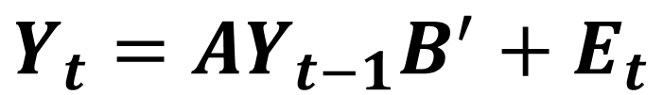
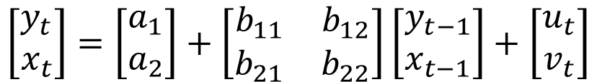


From VAR to MAR: Structured Coefficient Decomposition
Example Bivariate VAR(1) model - (yₜ, xₜ) and one lag:
$$y_{t}=a_{1}+b_{11}y_{t−1}+b_{12}x_{t−1}+u_{t}$$
$$x_{t}=a_{2}+b_{21}y_{t−1}+b_{22}x_{t−1}+v_{t}$$
$$Y_{t}=AY_{t−1}B^{′}+E_{t}$$
Matrix Representation
$$\left[\begin{matrix}y_{t} \\ x_{t}\end{matrix}\right]=\left[\begin{matrix}a_{1} \\ a_{2}\end{matrix}\right]+\left[\begin{matrix}b_{11} & b_{12} \\ b_{21} & b_{22}\end{matrix}\right]\left[\begin{matrix}y_{t−1} \\ x_{t−1}\end{matrix}\right]+\left[\begin{matrix}u_{t} \\ v_{t}\end{matrix}\right]$$
Coefficient matrix B from VAR has the same purpose as matrices A and B from MAR
Matrix A explain the column (state) interaction while matrix B explains the row (sector) dynamics

Slide 12
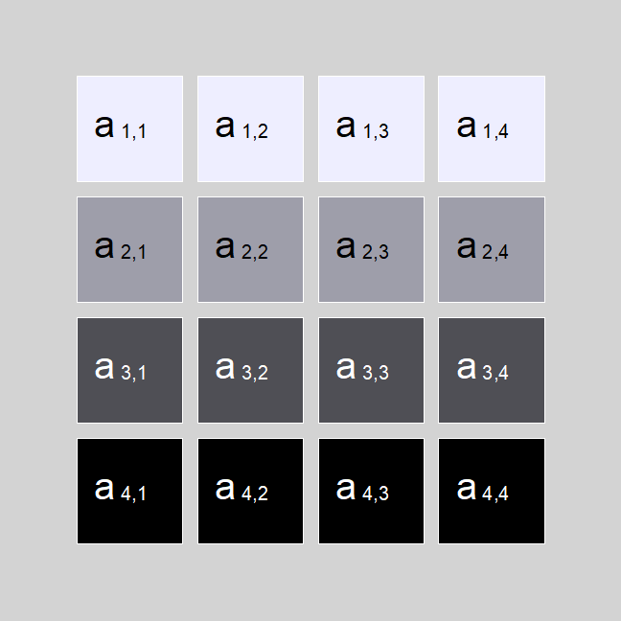
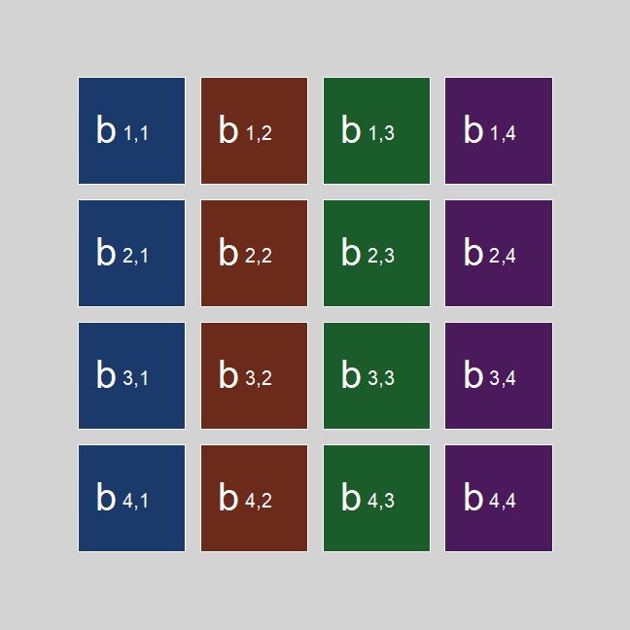
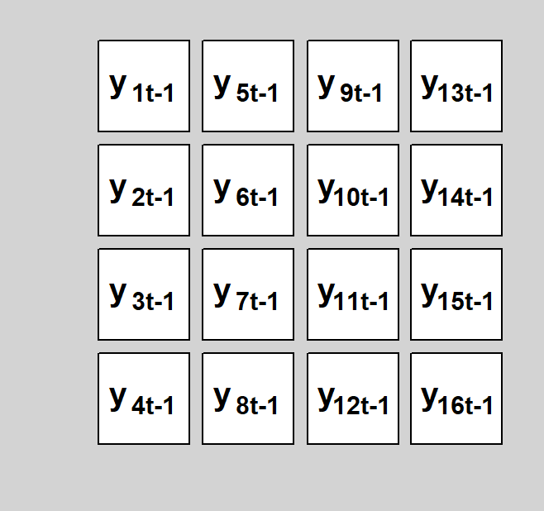
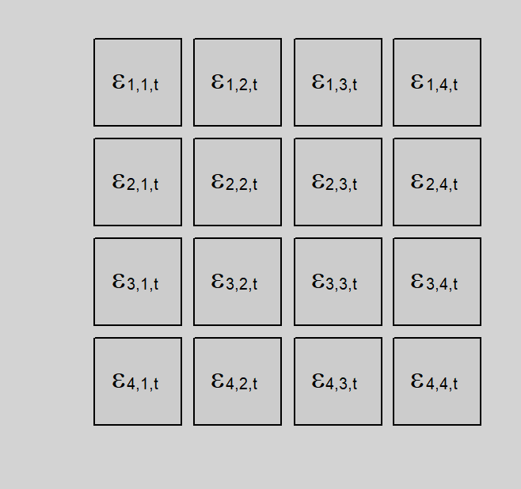
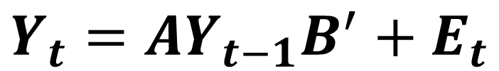





MAR
$$Y_{t}=AY_{t−1}B^{′}+E_{t}$$
=
x
x
$$Y_{t}$$
$$A$$
$$Y_{t−1}$$
$$B^{′}$$
+
$$E_{t}$$

Slide 13


Interpreting Matrices A and B
A answers: "Did high employment in state X last month predict high employment in state Y this month?" - it captures cross-state spillovers
B answers: "Did high employment in sector X last month predict high employment in sector Y this month?" - it captures cross-sector co-movement
A large off-diagonal entry in A or B means two states (or sectors) strongly influence each other
A near-diagonal matrix means each state/sector mostly evolves on its own
$$A$$
$$B^{′}$$

Slide 14

Estimation of A and B: 3 main methods
Projection method (PROJ): Estimate the full VAR first, then project it onto the Kronecker-product form. It is easy to understand and has a closed-form SVD step, but it is usually less accurate.
Iterated least squares (LSE): Estimate $A$ and $B$ directly by minimizing the MAR fitting error. It is more natural for the model and usually performs better than PROJ, but it requires an iterative algorithm.
MLE with structured covariance (MLEs): Jointly estimate $A$, $B$, and the row/column covariance structure. It is the most statistically efficient when that covariance assumption is correct, but also the most complex method.

Slide 15
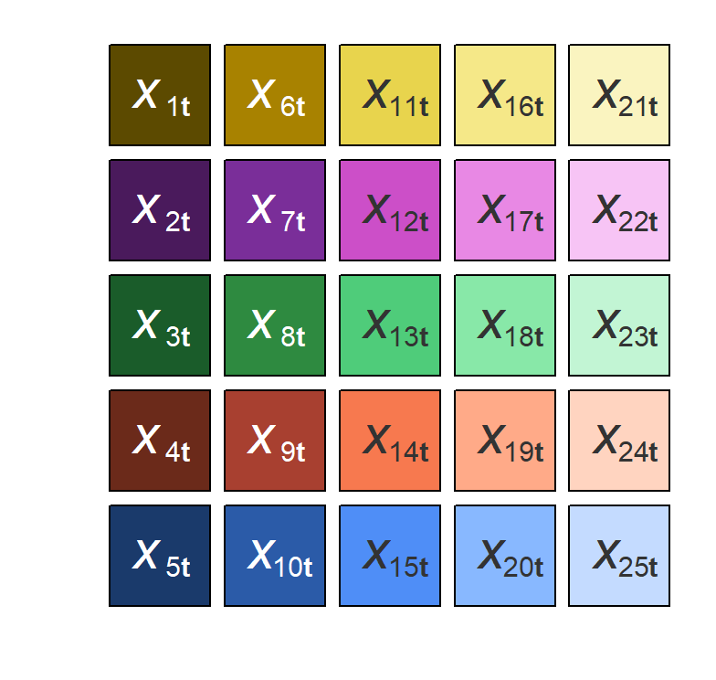
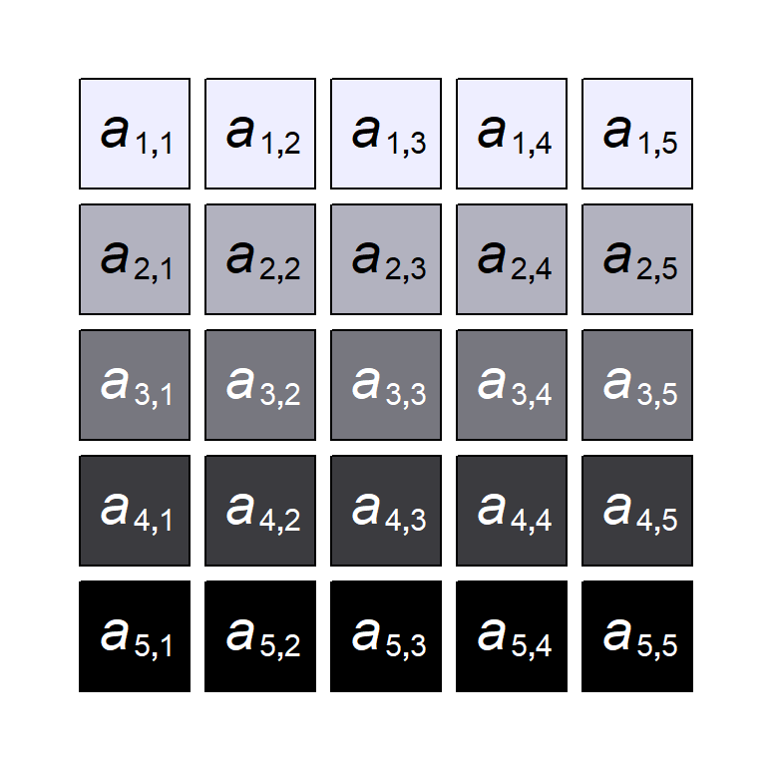
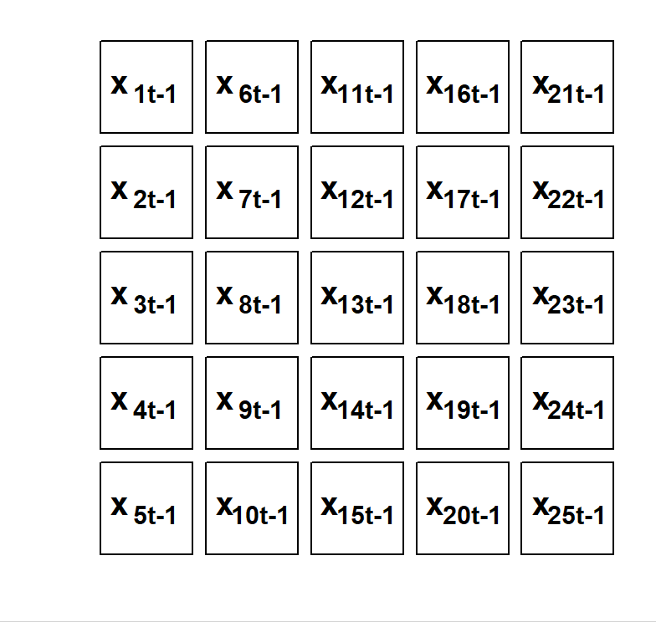
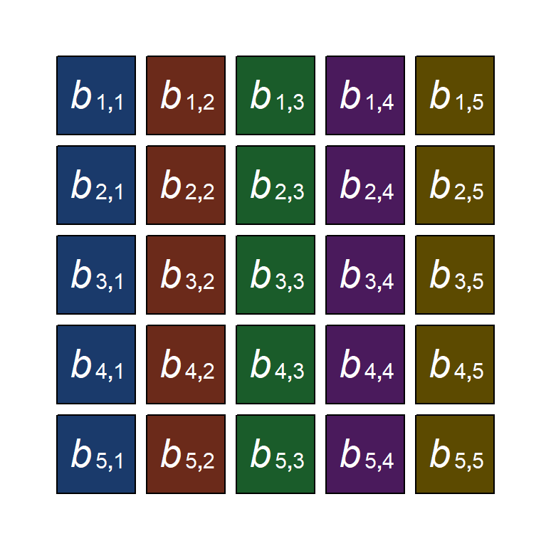
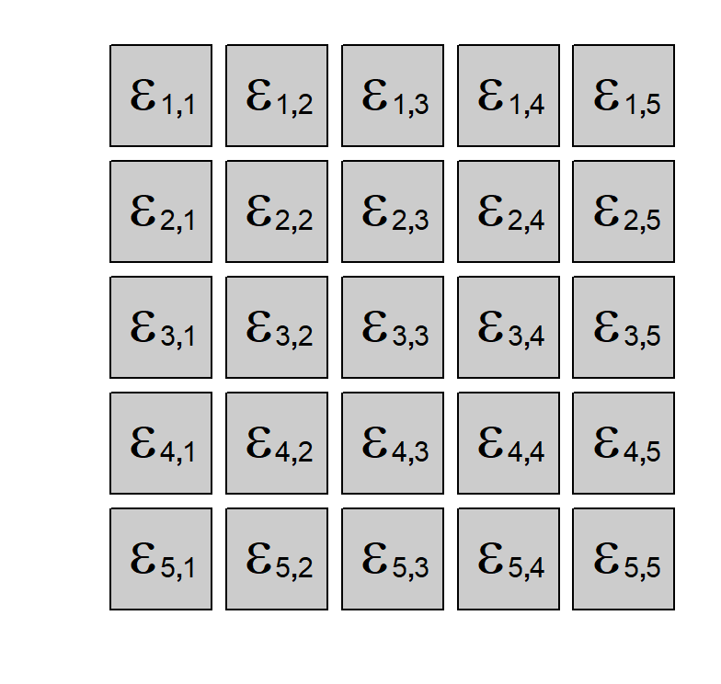
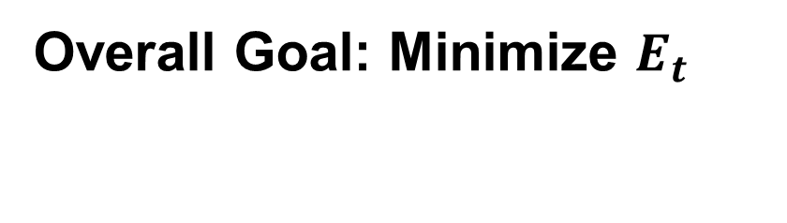

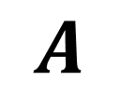
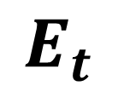

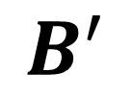
Estimation of A and B using LSE
Overall Goal: Minimize $E_{t}$
=
x
x
+
$$X_{t}$$
$$A$$
$$X_{t−1}$$
$$B^{′}$$
$$E_{t}$$

Slide 16

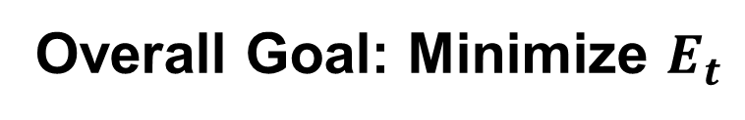




Estimation of A and B using LSE
Overall Goal: Minimize $E_{t}$
Step 1. Choose some specific matrix A and fix it Step 2. Calculate matrix B
=
x
x
+
$$Y_{t}$$
$$A$$
$$Y_{t−1}$$
$$B^{′}$$
$$E_{t}$$

Slide 17
Estimation of A and B using LSE
Overall Goal: Minimize $E_{t}$
Step 3. Fix matrix B Step 4. Recalculate matrix A
=
x
x
+
$$Y_{t}$$
$$A$$
$$Y_{t−1}$$
$$B^{′}$$
$$E_{t}$$

Slide 18
Estimation of A and B using LSE
Overall Goal: Minimize $E_{t}$
Step 5: Repeat iterating until the change in the objective function falls below a convergence threshold ε
=
x
x
+
$$Y_{t}$$
$$A$$
$$Y_{t−1}$$
$$B^{′}$$
$$E_{t}$$

Slide 19
What should we do?
We estimate A and B using the TensorTS package in R
Before fitting the model, data must be preprocessed into 3D tensor format (sectors × states × time)
Preprocessing steps: First Differencing (to achieve stationarity) and ADF stability check
Note: the BLS data reports employed persons, not unemployment counts - first differences approximate month-over-month employment changes

Slide 20

Preprocessing our data
This is how our initial data looks like
Just by looking at it we can already say that it is non-stationary
Non-stationary data violates the stability conditions required by the MAR model
We apply First Differencing: $Δy_{t}=y_{t}−y_{t−1}$ to remove trends and approximate stationarity

Slide 21
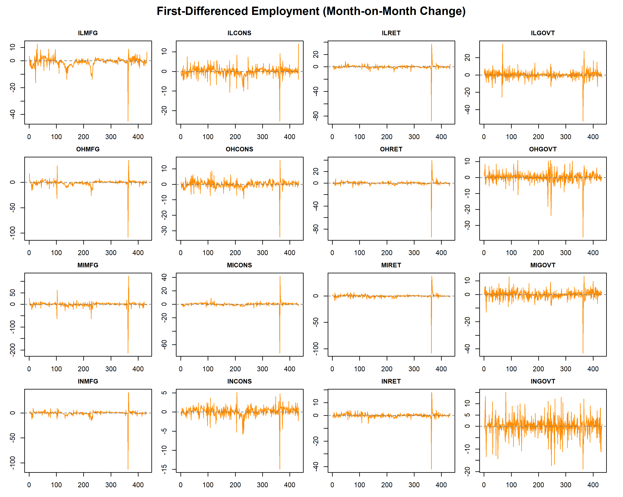
Preprocessing our data
After first differencing, series fluctuate around zero with no visible trend - consistent with stationarity
Formal confirmation requires the Augmented Dickey-Fuller (ADF) test
ADF null hypothesis: the series has a unit root (non-stationary); rejection confirms stationarity

Slide 22
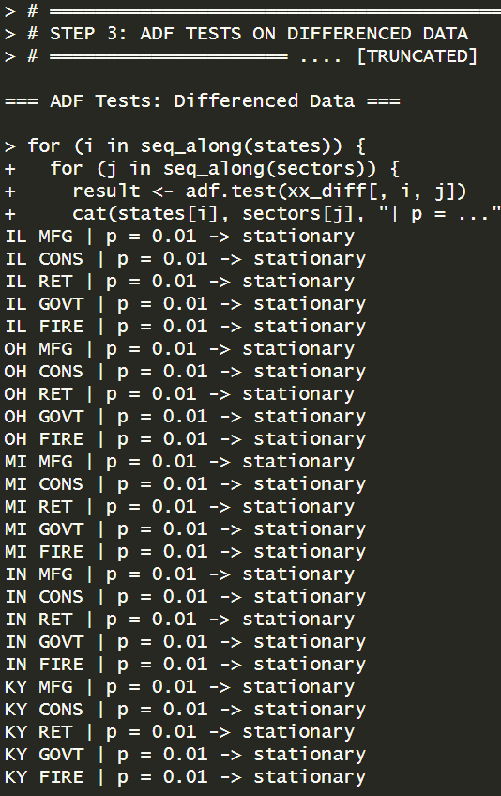
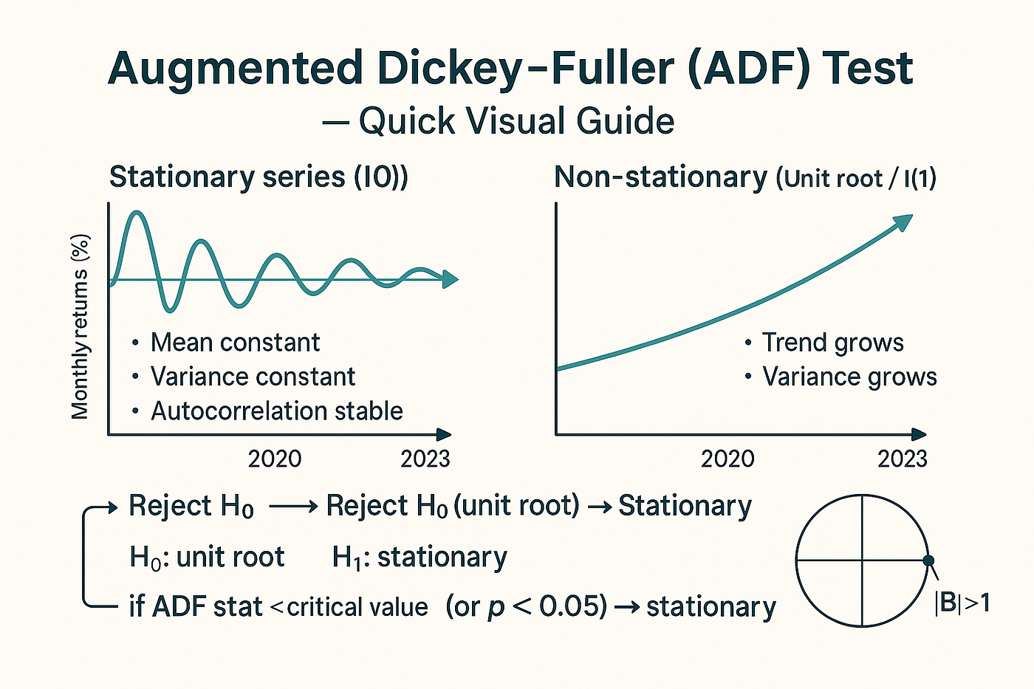
Preprocessing our data
Stability check using ADF
R output ADF

Slide 23


Results for A and B using LSE

Slide 24
Future work
Eigenvalue check - verify that the spectral radius of A ⊗ B is less than 1, confirming the model is stable and stationary
Residual check - inspect residual matrices for autocorrelation to confirm the model captures the dynamics adequately
Compare 3 estimation methods - run PROJ, LSE, and MLEs on our data and compare the estimated A and B matrices across methods to see how sensitive results are to the choice of estimator
Economic interpretation - interpret the off-diagonal entries of A and B to identify which states and sectors most strongly influence each other (e.g., does a drop in Illinois manufacturing spill over into Ohio?)
Extend to MAR(p) - test whether adding a second lag MAR(2) improves model fit, capturing slower-moving employment dynamics
Out-of-sample forecasting - use the fitted MAR model to predict next month's employment matrix and compare forecast accuracy against a simple VAR benchmark

Slide 25
Thank you for your attention!
Q&A

